Slide 1
MUNSJUK
Quick, easy and reliable smartphone-based diagnostics for oral forms of STIs.

Slide 2
“More than 1 million STIs are acquired every day worldwide” – WHO, 28/02/19

Slide 3
Potential to save the NHS £10-50 million

Slide 4
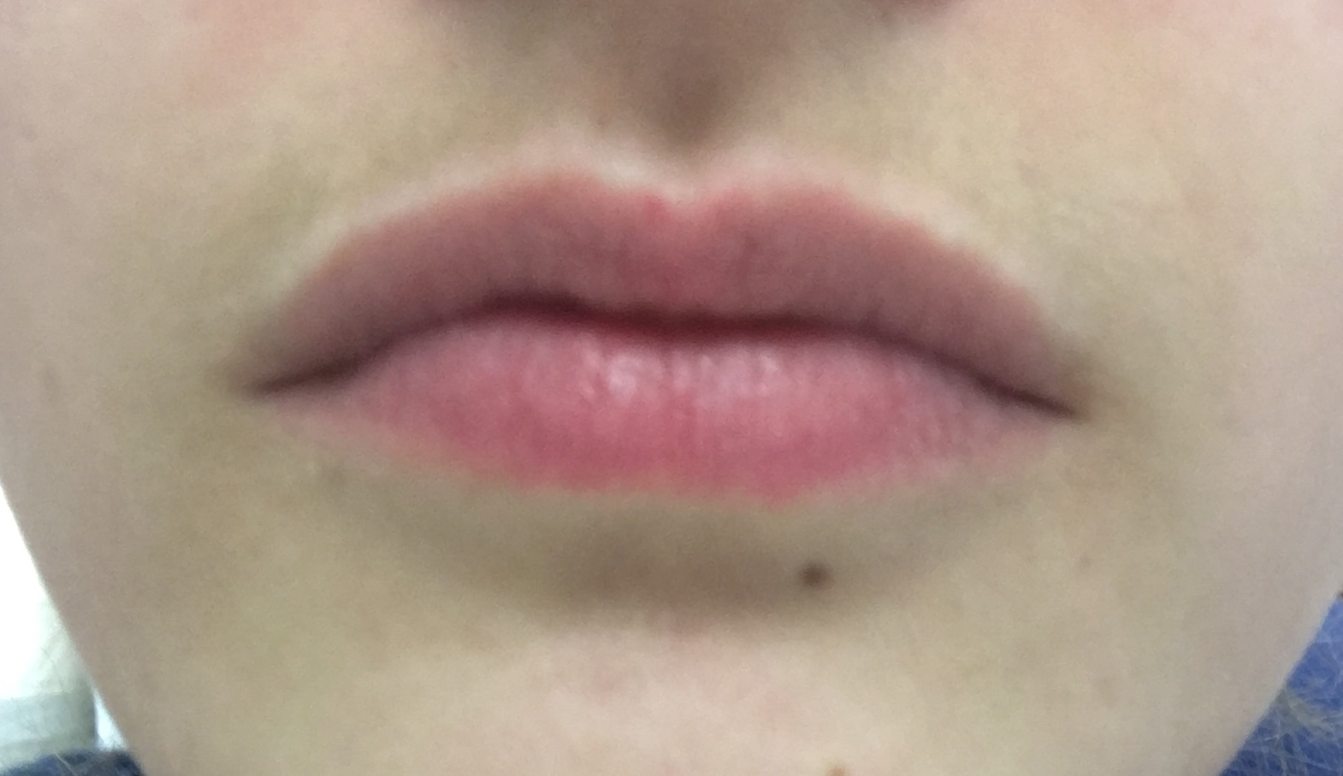
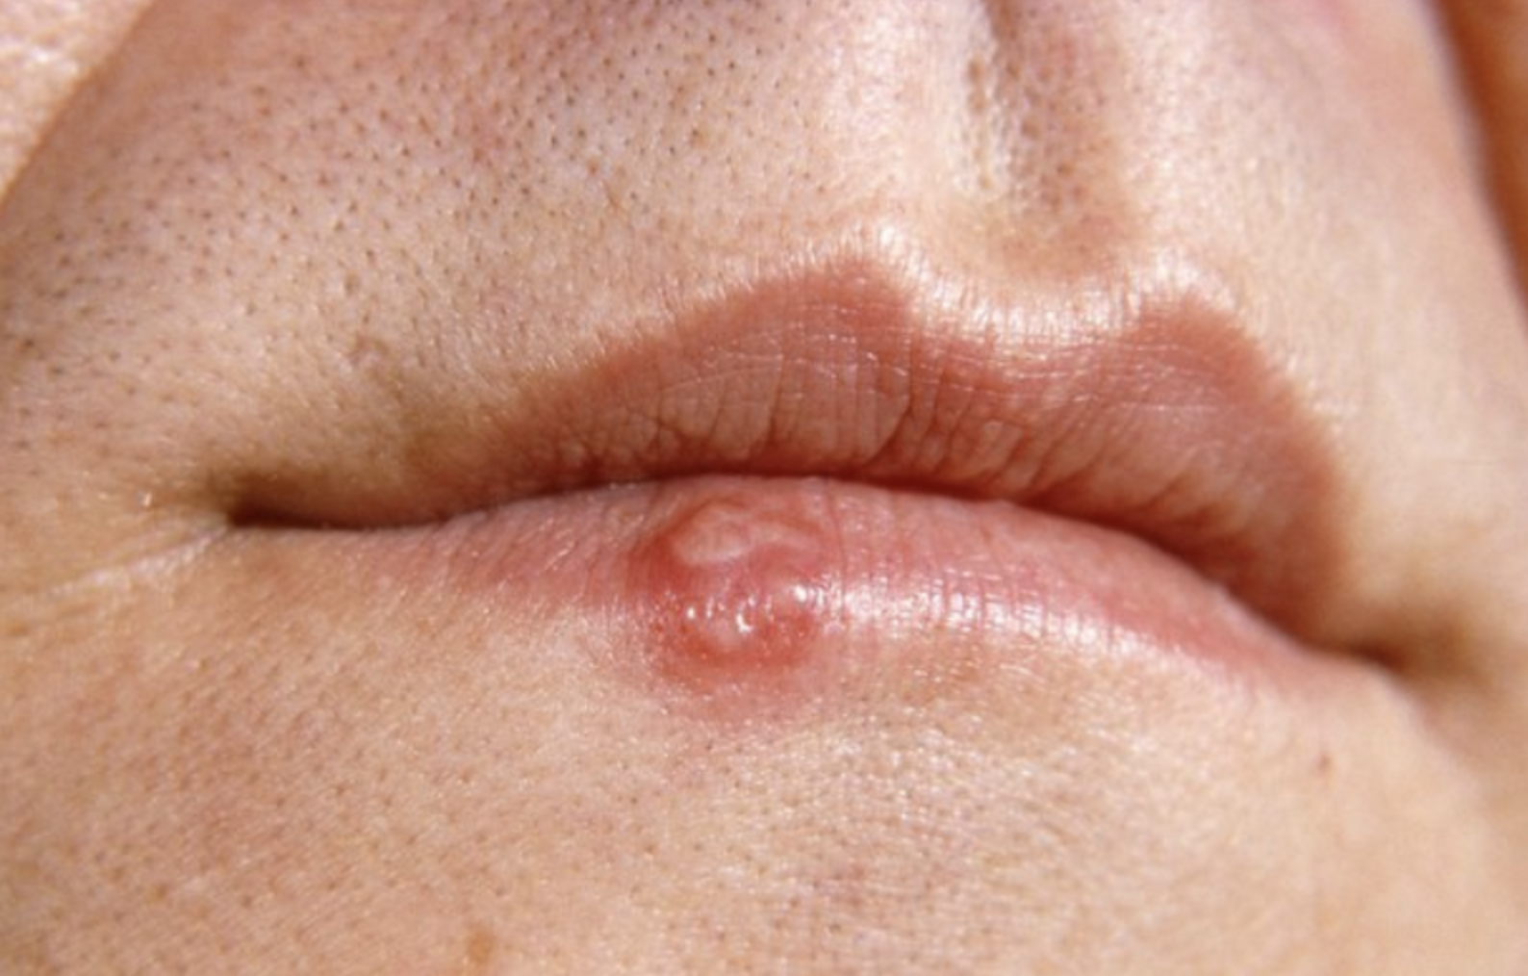
(healthy example)
Herpes

Slide 5
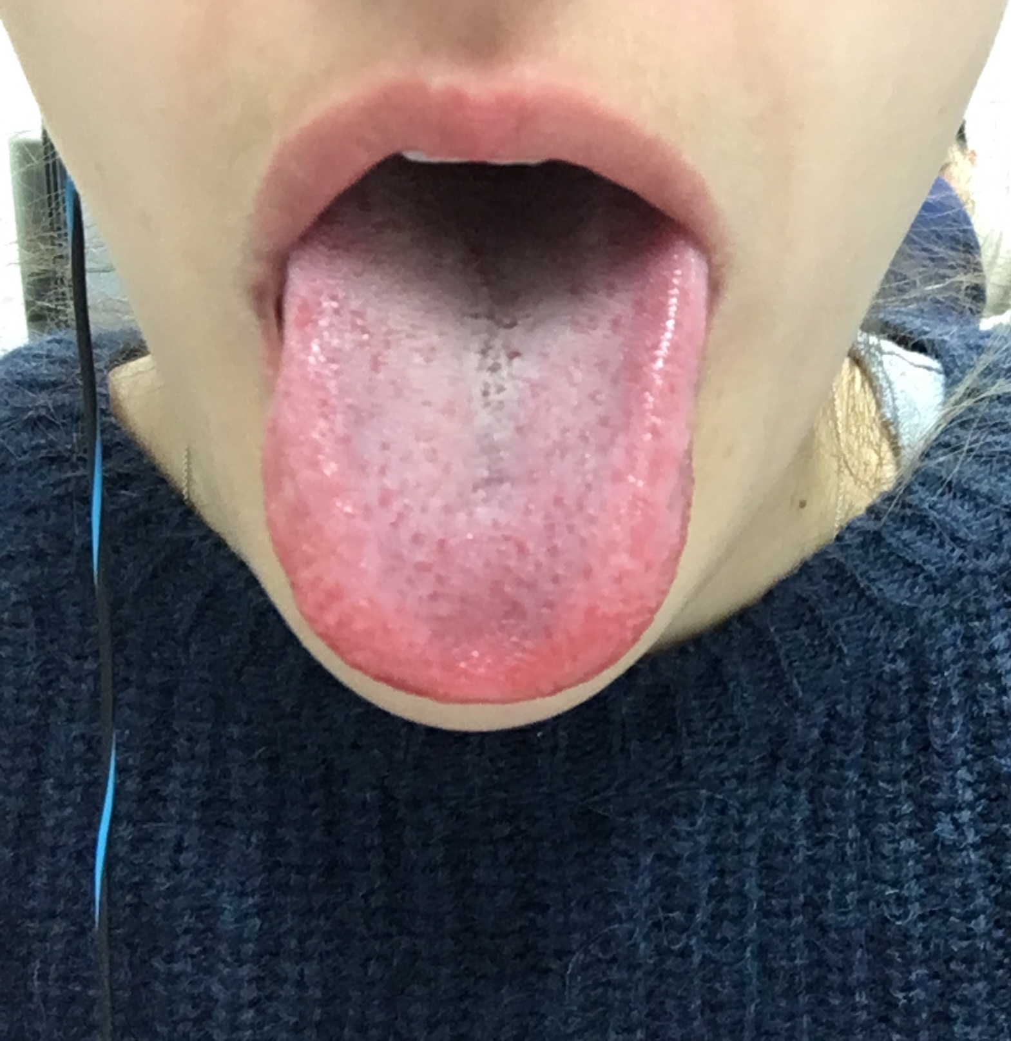
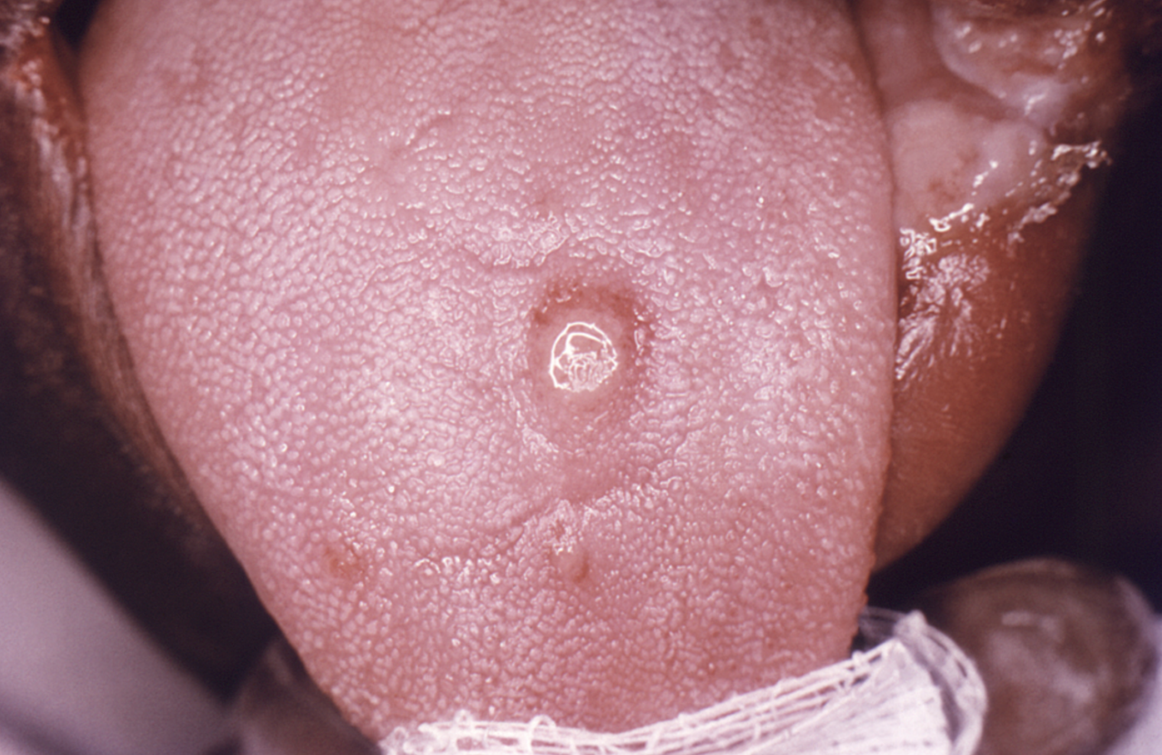
(healthy example)
Syphilis stage 1

Slide 6
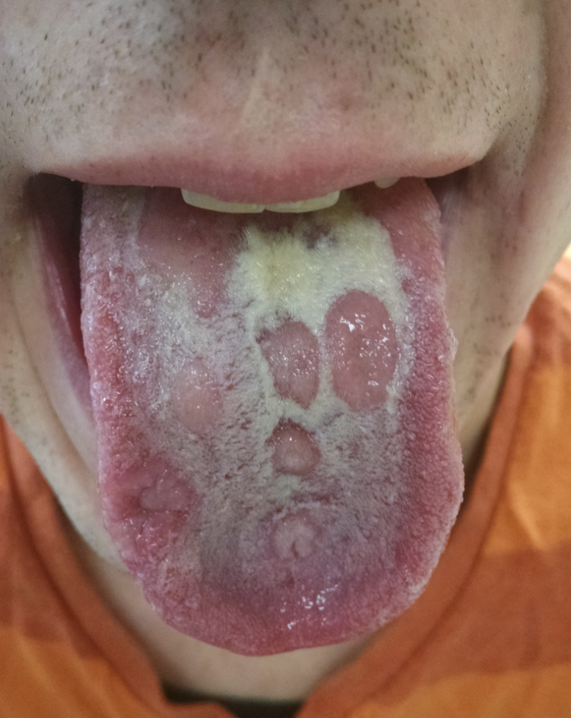
(healthy example)
Syphilis stage 2

Slide 7
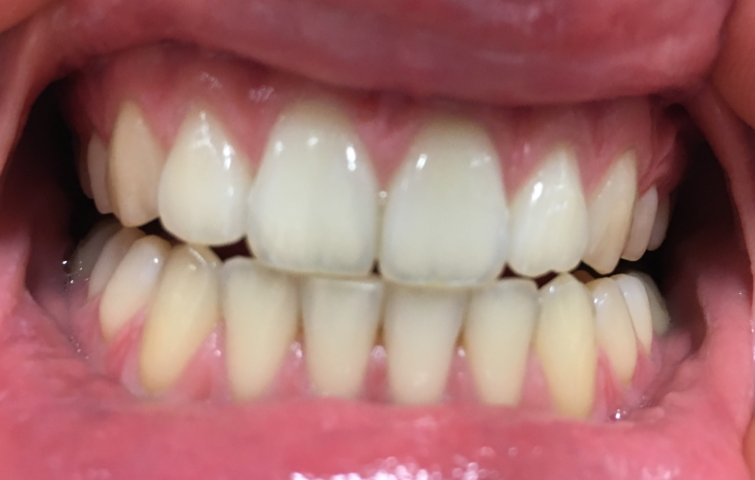
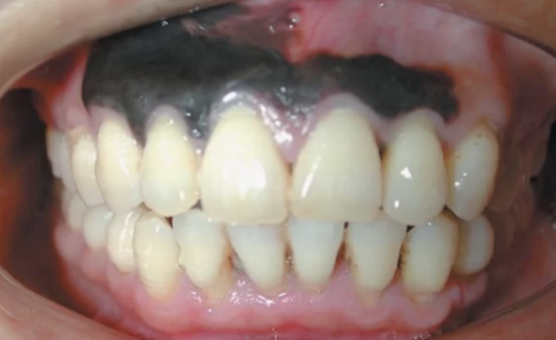
(healthy example)
Oral cancer

Slide 8
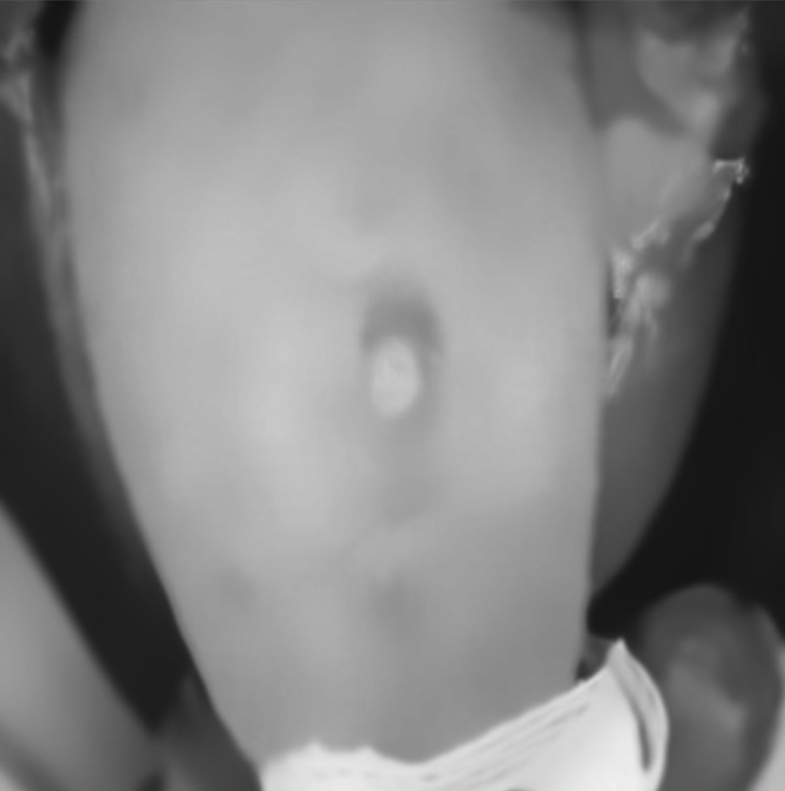
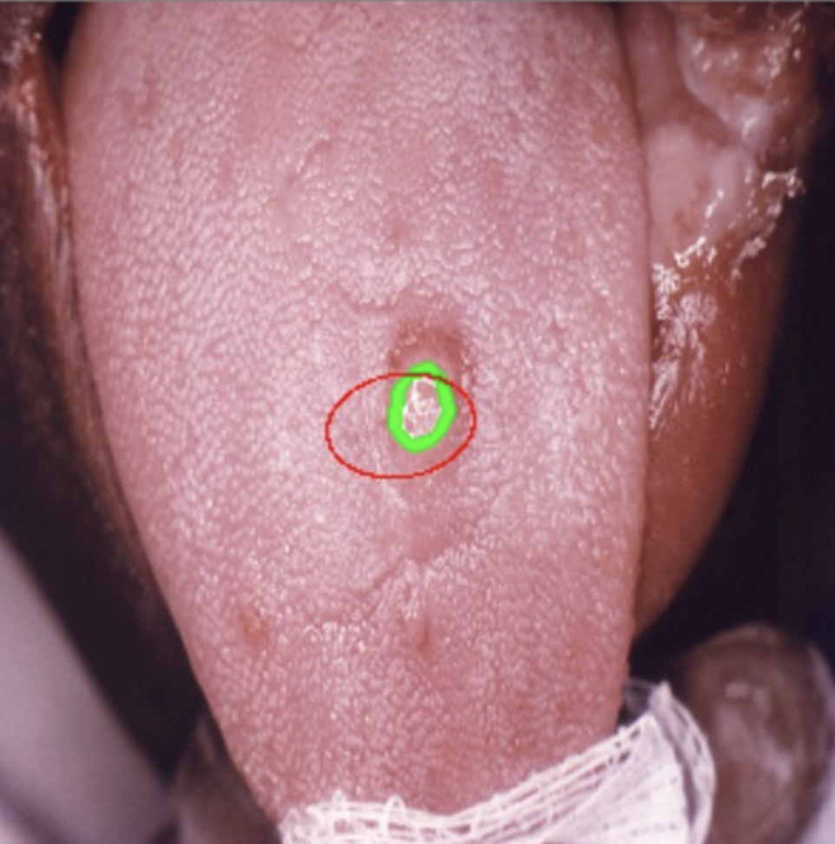

Slide 9
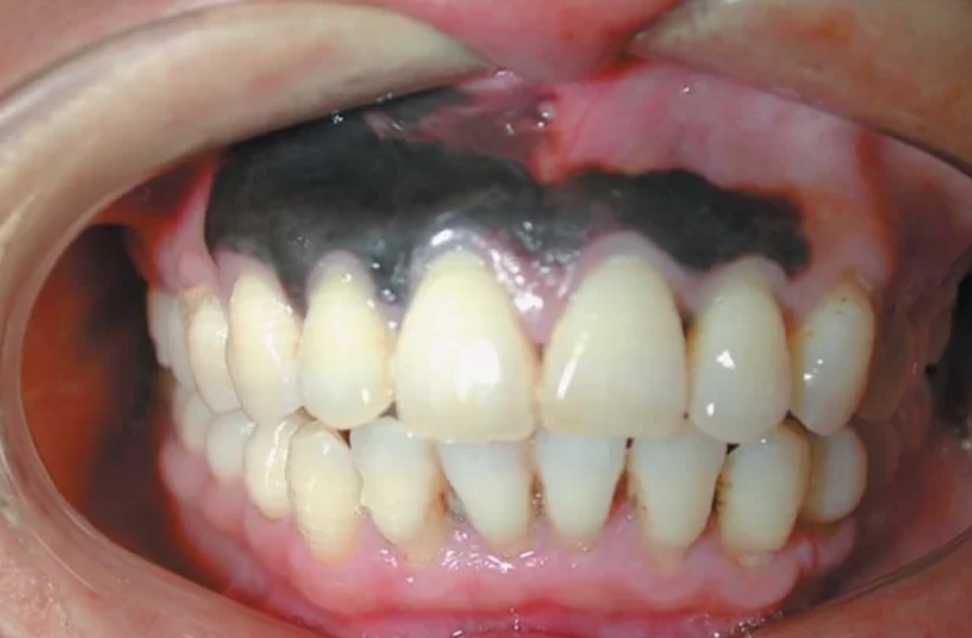
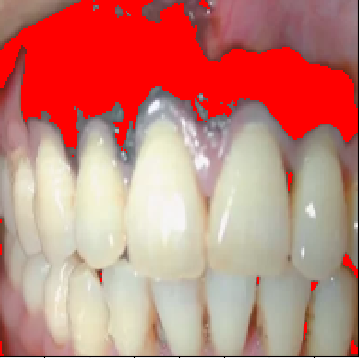

Slide 10
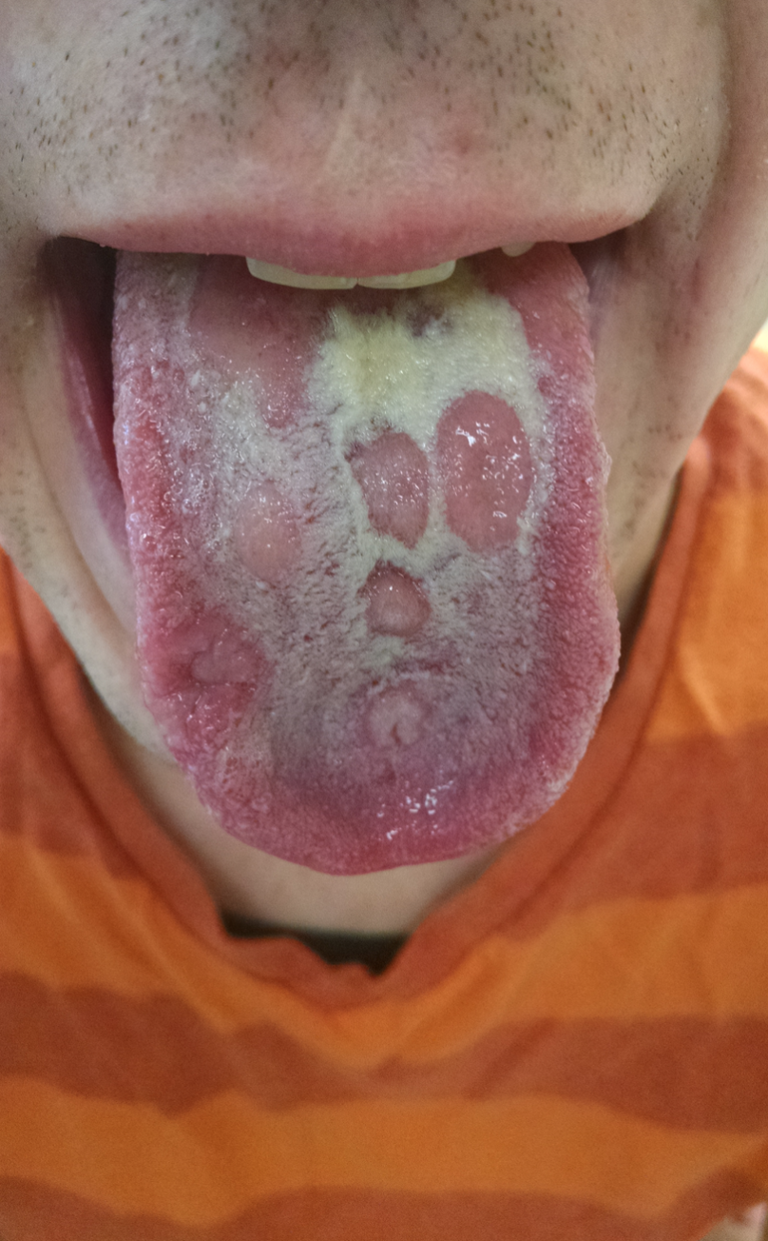
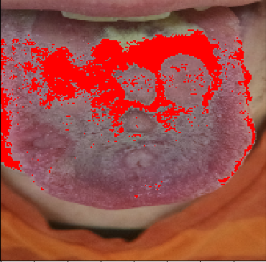

Slide 11
Do you have any active disease effecting your immune system?
NO
YES
Have the symptoms been present for more than 10 days?
YES
Please go see your PG as soon as possible as this may have serious implications
NO
Have you noticed similar symptoms more than 3 or 4 times in the last year?
YES
This is a highly infectious disease!
NO
This is not something to worry about. If these symptoms persist for over 10-14 days, we would recommend seeing a medical professional.
If you are experiencing any pain, please see a pharmacist

